Slide 1



Case Management Participant Handbook
It is the Mission of our Case Management team: To assist individuals with developmental disabilities in Lincoln County with identifying needs, linking them to necessary resources & supports and assuring satisfaction with services.

Slide 2

About Community Opportunities
Community Opportunities is a local agency who helps people, living in Lincoln County, who have developmental disabilities (such as autism, cerebral palsy and mental retardation).

Slide 3
What will Community Opportunities Case Management offer you?
We will help you develop an individual plan to make sure you get the supports you need.
Help you access community resources.
Monitor your services to assure they are helpful.
Help you complete, read and understand paperwork related to your services.
Get you information quickly.
Provide you conflict-free services (This means we will make sure your case management provider and direct service provider are not the same organization so there isn’t a “conflict of interest”.)

Slide 4
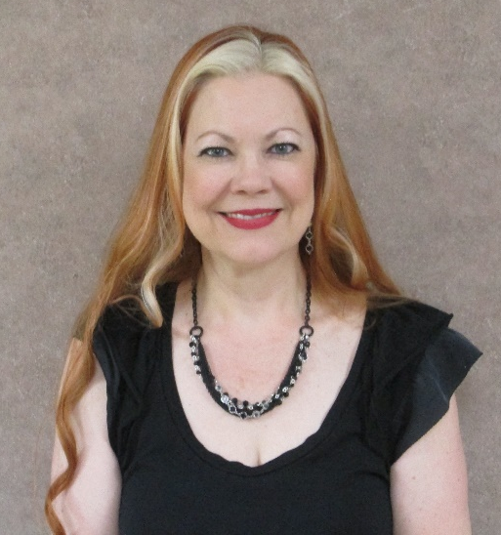
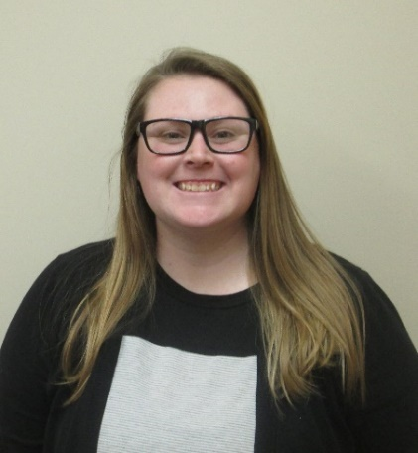
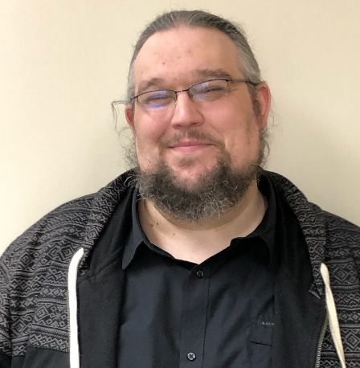
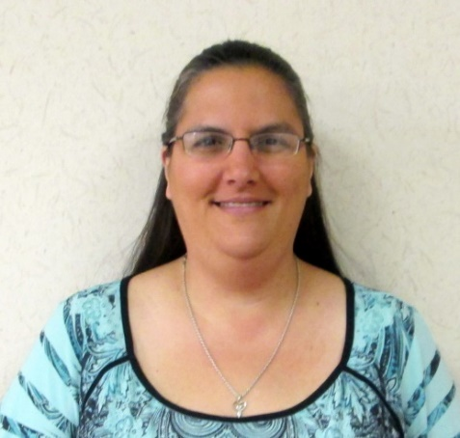
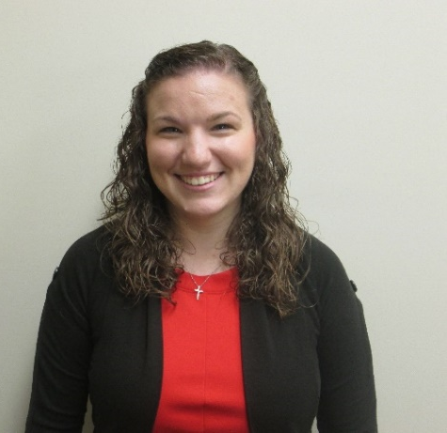
Our Case Management staff have many years of combined experience helping people with developmental disabilities. They are Professional Managers (PM), which means they must have a Bachelor’s Degree and meet other specific criteria required by the Department of Mental Health.

Slide 5

Admission to Case Management
12 or older & have a developmental disability
Live in Lincoln County
Not receiving other direct services from Community Opportunities
(to be conflict-free)
Apply for and accept active Medicaid (if approved)

Slide 6

Admission to Case Management
If not approved for Medicaid we will still provide basic Case Management Supports
If you are not eligible for our services we will assist you with finding other resources.

Slide 7
There is a cost for Case Management but it is paid by your Missouri HealthNet coverage and by the Department of Mental Health.
You personally will not have to pay for Case Management services.

Slide 8


We will accommodate you…
If you need reasonable accommodations such as an interpreter or help getting into and out of a building, or language assistance if you have limited understanding of English, let us know and we will do everything we can to assist you.

Slide 9

Equal Opportunities for Everyone
We will help you no matter what your race, color, religion, national origin, citizenship, ancestry, sex, age, disability, marital status, genetic information or veteran status.
Any beliefs you have will not change the way we treat you.

Slide 10

You have the same legal rights and responsibilities as any other person unless the court says you do not (if you have a guardian your rights will be different than people without a guardian).
You will be given a written copy of your rights. If any changes are made you will receive a new copy. If you need assistance reading or understanding your rights our staff can help you.
Your rights cannot be taken away/limited before you have a chance to speak for yourself or have someone you choose speak for you. This is called due process.

Slide 11


Risk vs Choice
If you choose to do something your team feels is too risky, the team will meet to discuss this activity. They will try to come to an agreement with you by deciding what risks there are, whether or not the risks are too great, and/or how we can work together to make the risks smaller so you can continue to do what you have chosen. Your guardian, if you have one, will be involved in these decisions.
You are ultimately responsible for your behavior. If you damage something, you will have to pay for it (up to $50).

Slide 12

Your Rights
You have the right to be free from abuse, neglect, humiliation, financial or other exploitation and retaliation.

Slide 13
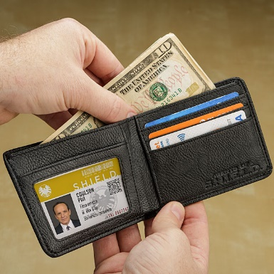


You Have The Right
To control your personal money and
have a job to make money.
To have privacy and talk to who you
want to privately and have your information
kept private.
To keep things of your own and see
current news and media.

Slide 14



You Have The Right
To choose where and with whom you want to live.
To be a part of the community and participate in activities with people you choose.
To attend a place of worship of your choice, if you choose to do so.

Slide 15
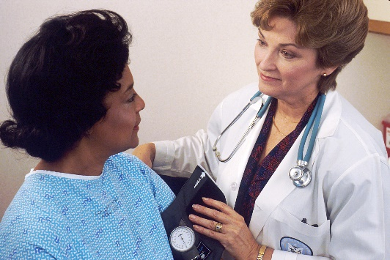


You Have The Right
To go to the doctor or hospital
when you need to.
To lead/participate in your plan meeting and invite those who are important to you & have your plan clearly explained to you.
To receive rules, policies and information about you in a way you can understand.

Slide 16
You have the Right to
Have choices of who supports you and to
Say “Yes” or “No” to Services
Notes:
You have the right to say Yes or No to Services

Slide 17



You Have The Right
To say NO to being part of any study, experiment or medical treatment.
To choose someone to help you make decisions or act on your behalf.
To have a person who does not work for our agency decide if we are complying with your rights.
Your Rights

Slide 18
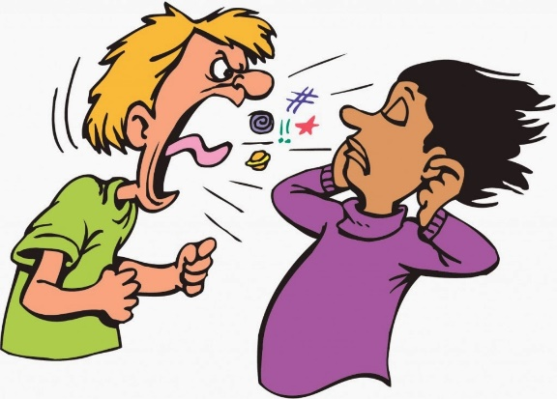

You have the Right:
To be free from people hitting you, hurting you, yelling at you, saying hurtful things or restricting your movement.
To be treated with respect at all times and to be treated like everyone else under the law.

Slide 19
Abuse & Neglect
You have the right to not be abused or neglected.
“Abuse” can be someone hurting you (either your body or your feelings, like someone calling you bad names).
“Neglect” is not getting the things/attention you need to be healthy and safe.
If you feel you have been abused, tell the staff or someone else in charge. They will let the right people know. Your staff are required to report any abuse or neglect they see or that people report to them.
We do not tolerate abuse or neglect and will make sure the issue is investigated and resolved as quickly as possible.

Slide 20

Formal vs Informal Complaint
What's the difference between a formal and an
informal complaint?
An informal complaint is different from a formal complaint/grievance in how it is processed; however, resolution is the goal for each. An informal complaint is generally resolved through discussion and should always be attempted before moving into the formal complaint/grievance process.
You can make an informal complaint to the Director of the department you receive services (your support staff can assist you if needed). If you do not feel like your issue is resolved after making an informal complaint, you can make a formal complaint.
The formal complaint process is started when you, your guardian or family, completes a Grievance Form. After this form is processed, it is then investigated in accordance with our formal grievance procedure.
You will not be denied services or supports for making a complaint or grievance!

Slide 21

We will look into any reported issues or concerns you have with your services or supports and attempt to resolve them quickly.
Notes:
You have the right to offer complaints to the agency

Slide 22

We will try to help resolve any concerns you have, but if you feel like your rights are not being respected or you wish to report abuse or neglect you can call:
Department of Mental Health Office of Consumer Safety toll free at 1-800-364-9687 8a-5p Monday-Friday
Or
Missouri Department of Health and Senior Services toll free at 1-800-392-0210 24-hr
Or
Missouri Protection & Advocacy (for advocacy & legal services) toll free at 1-800-392-8667 or MO Relay (TDD) call 1-800-735-2966
You can call anonymously (which means you do not have to tell them who you are).

Slide 23
Information about you will be kept private
Notes:
You have the right to have information about you kept private

Slide 24


Your Rights under HIPAA
Some of your rights are….
You can:
see a copy of your records
ask for changes to your information
ask with whom we have shared your information
talk to us at your home or in the office
have full copy of the Notice of Privacy Practices
make a complaint if you think any of your rights have not been met
Notes:
Your rights under HIPAA (the Health Insurance Portability and Accountability Act)
You can – see a copy of your records, ask for changes to your information, ask who we have given your information to, talk to us at your home or in the office, have a full copy of your Notice of Privacy Practices, make a complaint if you think any of your rights haven’t been met

Slide 25

Your Personal Information
Community Opportunities can give information about you without your permission for your treatment, payments of services or healthcare operations. So, we may share information with doctors, emergency staff, insurance companies or other agencies to make sure you have the care you need.
Notes:
Your Personal Information. Community Opportunities can give information about you to doctors, emergency staff, insurance companies or other agencies to make sure you have the care you need without asking you if it’s okay.

Slide 26

Why Choose Community Opportunities?
We have been helping people with developmental disabilities, in Lincoln County, for over 40 years
Our Case Managers assist fewer people than other agencies, which means more time for you
We promise to get to know you and your needs
We will help you get what you need

Slide 27
Community Resources
We have many resources available to you.
You can request a list from your case management staff.
If you need help with something that is not on the list, please let us know.

Slide 28
Do you have any questions?

