Slide 1






Employment Services
Participant Handbook

Slide 2
Supported Employment
We are here to help people with disabilities find and keep jobs.
Employment First: All people with disabilities should have opportunities to work!
Employment Services Mission: To provide job training and increase productivity of each individual to achieve their fullest potential in their desired work.

Slide 3
Supported Employment Process
We get your name usually from Vocational Rehabilitation (VR) telling us you would like us to help you find a job.
We will meet with you and your VR Counselor to talk about work you have done, if any, what type of job you would like to have and training you will need. You can invite your family, friends or anyone you choose to this meeting.
We will get information about you from other agencies that have helped you.
You will be introduced to an Employment Specialist, who will be assigned to help you and will meet with you one time weekly for the next month or so.
The Employment Specialist will help you fill out forms and can meet with you at your home or school (if you are a student) and talk to a few of your friends, family members, teachers and other important people in your life that know you well.
The Employment Specialist will go with you to see and maybe even try out some work sites in the community to see what kind of work you like and can do best.

Slide 4
Supported Employment Process
7. You, your VR Counselor and Employment Specialist will meet again to decide if you are ready to look for a job or if you need to try a few other things first.
8. If you are ready to look for work, your Employment Specialist will help you create a resume, fill out applications and do practice interviews.
9. When you get a job, the Employment Specialist will help you get to know your boss and co-workers. They will stay with you at your job until you are able to do it without help.
10. After you are at the job on your own, the Employment Specialist will check on you occasionally to make sure things are going good. It is up to you to do your best and do all the work given to you!
We meet several times a year as a group so you can tell us how you like your programs and if you want to make any changes. You can also tell us if you want to change the rules. We will vote on all changes.

Slide 5
Staff Who Work with You
When employment support staff is hired they must have at least a high school diploma or GED, a valid driver’s license, and pass specific background checks.
All staff working with you receives at least 80 hours of training.
Employment staff have training in CPR, First Aid and preventing abuse and neglect.
They also receive training in positive behavior support, confidentiality and emergency situations.
Our Employment Specialists are Certified Employment Training Specialists. This means they have specific training so they know how to help you find and keep a job.
Your services are developed with you and supervised by a Professional Manager (PM). This person has Bachelor’s Degree and has worked at least one year with individuals with developmental disabilities.

Slide 6

Fees for Services
There are fees for Employment Services.
Most fees are paid by the Division of Vocational Rehabilitation (VR).
In some cases, Community Opportunities will pay part of the fees too.
A list of fees and who will pay for them will be given to you upon request.

Slide 7
Rules and Responsibilities
You must be on time for all meetings and for your job.
You should be dressed neatly and appropriately for the type of work you will be doing.
You should do as much for yourself as you can.
Once you have a job, you must follow all the rules at your job site.
Alcohol or illegal drugs are not allowed in the office or while you are at work. You can smoke in designated smoking areas during your breaks.
You are responsible for your behavior. If you damage something, you will have to pay for it (up to $50).

Slide 8


We will accommodate you…
If you need reasonable accommodations such as an interpreter or help getting into and out of a building, or language assistance if you have limited understanding of English, let us know and we will do everything we can to assist you.

Slide 9

Equal Opportunities for Everyone
We will help you no matter what your race, color, religion, national origin, citizenship, ancestry, sex, age, disability, marital status, genetic information or veteran status.
Any beliefs you have will not change the way we treat you.

Slide 10

Non-Participation
by Employment Clients
It is important for you to attend service appointments as scheduled. When you do not attend appointments it affects services for other clients, staff schedules and how the agency is paid for services. Not attending as scheduled is called “non-participation” when you miss 2 scheduled appointments over an 8 week period or 3 scheduled appointments in a row.
If non-participation occurs, a letter will be sent to you/your guardian requesting a meeting. If you or your guardian do not respond to 2 follow-up calls to schedule the meeting, or do not attend the meeting once it is scheduled we will probably stop scheduling services with you. You will have to reapply for services if you want them in the future.

Slide 11

Risk vs Choice
If you choose to do something your team feels is too risky, the team will meet to discuss this activity. They will try to come to an agreement with you by deciding what risks there are, whether or not the risks are too great, and/or how we can work together to make the risks smaller so you can continue to do what you have chosen. Your guardian, if you have one, will be involved in these decisions.

Slide 12

Your Rights
You have the right to be free from abuse, neglect, humiliation, financial or other exploitation and retaliation.

Slide 13
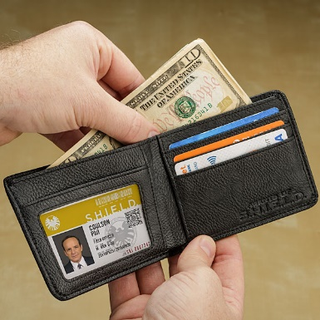


You Have The Right
To control your personal money and
have a job to make money.
To have privacy and talk to who you
want to privately and have your information
kept private.
To keep things of your own and see
current news and media.

Slide 14



You Have The Right
To choose where and with whom you want to live.
To be a part of the community and participate in activities with people you choose.
To attend a place of worship of your choice, if you choose to do so.

Slide 15
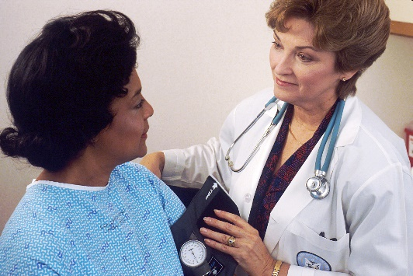


You Have The Right
To go to the doctor or hospital
when you need to.
To lead/participate in your plan meeting and invite those who are important to you & have your plan clearly explained to you.
To receive rules, policies and information about you in a way you can understand.

Slide 16
You have the Right to
Have choices of who supports you and to
Say “Yes” or “No” to Services
Notes:
You have the right to say Yes or No to Services

Slide 17



You Have The Right
To say NO to being part of any study, experiment or medical treatment.
To choose someone to help you make decisions or act on your behalf.
To have a person who does not work for our agency decide if we are complying with your rights.
Your Rights

Slide 18


You have the Right:
To be free from people hitting you, hurting you, yelling at you, saying hurtful things or restricting your movement.
To be treated with respect at all times and to be treated like everyone else under the law.

Slide 19
Abuse & Neglect
You have the right to not be abused or neglected.
“Abuse” can be someone hurting you (either your body or your feelings, like someone calling you bad names).
“Neglect” is not getting the things/attention you need to be healthy and safe.
If you feel you have been abused, tell the staff or someone else in charge. They will let the right people know. Your staff are required to report any abuse or neglect they see or that people report to them.
We do not tolerate abuse or neglect and will make sure the issue is investigated and resolved as quickly as possible.

Slide 20

Formal vs Informal Complaint
What's the difference between a formal and an informal
complaint?
An informal complaint is different from a formal complaint/grievance in how it is processed; however, resolution is the goal for each. An informal complaint is generally resolved through discussion and should always be attempted before moving into the formal complaint/grievance process.
You can make an informal complaint to the Director of the department you receive services (your support staff can assist you if needed). If you do not feel like your issue is resolved after making an informal complaint, you can make a formal complaint.
The formal complaint process is started when you, your guardian or family, completes a Grievance Form. After this form is processed, it is then investigated in accordance with our formal grievance procedure.
You will not be denied services or supports for making a complaint or grievance!

Slide 21

We will look into any reported issues or concerns you have with your services or supports and attempt to resolve them quickly.
Notes:
You have the right to offer complaints to the agency

Slide 22

We will try to help resolve any concerns you have, but if you feel like your rights are not being respected or you wish to report abuse or neglect you can call:
Department of Mental Health Office of Consumer Safety toll free at 1-800-364-9687 8a-5p Monday-Friday
Or
Missouri Department of Health and Senior Services toll free at 1-800-392-0210 24-hr
Or
Missouri Protection & Advocacy (for advocacy & legal services) toll free at 1-800-392-8667 or MO Relay (TDD) call 1-800-735-2966
You can call anonymously (which means you do not have to tell them who you are).

Slide 23
Information about you will be kept private
Notes:
You have the right to have information about you kept private

Slide 24

Your Personal Information
Community Opportunities can give information about you without your permission for your treatment, payments of services or healthcare operations. So, we may share information with doctors, emergency staff, insurance companies or other agencies to make sure you have the care you need.
Notes:
Your Personal Information. Community Opportunities can give information about you to doctors, emergency staff, insurance companies or other agencies to make sure you have the care you need without asking you if it’s okay.

Slide 25

Your Rights under HIPAA
Some of your rights are….
You can:
see a copy of your records
ask for changes to your information
ask with whom we have shared your information
talk to us at your home or in the office
have full copy of the Notice of Privacy Practices
make a complaint if you think any of your rights have not been met
Notes:
Your rights under HIPAA (the Health Insurance Portability and Accountability Act)
You can – see a copy of your records, ask for changes to your information, ask who we have given your information to, talk to us at your home or in the office, have a full copy of your Notice of Privacy Practices, make a complaint if you think any of your rights haven’t been met

Slide 26
Community Resources
We have many resources available to you.
You will receive a list from your
Employment Specialist.
If you need help with something that is not on the list, please let us know.

Slide 27
Re-Entry Policy
If you decide you no longer want our help finding a
job and then later want to come back and have us
help you again, you can let us know.
You will have to call your Vocational Rehabilitation
(VR) Counselor and have a meeting with them
before we can start helping you again.
.

Slide 28
Do you have any questions?

