Slide 1



Community Services
Participant Handbook

Slide 2

Community Services
We help people with developmental disabilities do as much for themselves as they can.
Community Services Mission: To provide community inclusion services while ensuring maximum use of natural supports and client choice.

Slide 3

Community Services offers:
Day Program and
Community Skills services
The service you are eligible to participate and how often you participate is determined by your individual needs, availability, and your funding options.

Slide 4
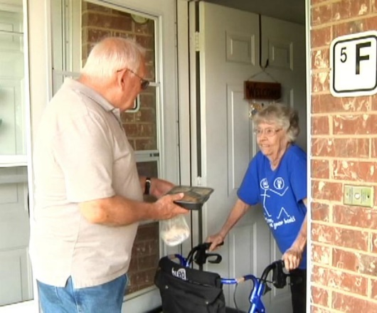
Day Program
Day Program is open Monday through Friday. Program hours are 8:15am to 3:15pm.
Individuals with developmental disabilities 18 years or older can participate.
This program teaches skills such as socialization, communication, positive behavior development, self-direction, community and daily living skills.
The majority of the support takes place at
community volunteer sites. This allows
participants to develop needed skills and
friendships with people other than paid staff.

Slide 5




Day Program
Services can be provided individually
or in a group, depending on individual needs.
Participants are required to bring a sack lunch each day and a change of clothes to be kept at the day program site.
Spending money can be kept at the program in a
lock box for activities that have a cost. You can
get your money at any time by asking staff.

Slide 6


Community Skills Program
The Community Skills program is open Monday through Saturday. The program does not provide overnight support, but the times of service are flexible to meet your individual support needs and choice of activities.
Individuals with developmental disabilities of all
ages can participate in this program.
This program teaches skills such as socialization, communication, positive behavior development, self-direction, community and daily living skills.

Slide 7


Community Skills Program
The majority of the support takes place in the community when possible. This allows participants to develop needed skills and friendships with people other than paid staff.
You will need to bring spending money from home to cover costs for any activity fees and sometimes may also need to pay the activity fee for the staff person with you.

Slide 8

Community Services
Process
1. First, we get your name as a person who would like to be a part of one of our programs. We talk with you and other important people in your life about what we do to determine which program would be the most helpful.
2. We will get information about you from other agencies that have helped you.
3. After talking with you, a day to start will be set if:
a) There is an opening; b) You want to come; c) Funding money is available to pay for the services

Slide 9
Community Services
Process
4. During your first month, we will ask you lots of questions and fill out forms. These forms will help us learn what things you can do for yourself, what things you need help with and what things you would like to learn.
5. At the end of the first 30 days you will decide if you want to continue the program. If you do not want to continue we will help you find other services.
6. If you decide you do want to continue the program, we will meet with you, others important to you, and your Case Manager, to look at your Individual Plan. Changes can be made based on your needs, desires and choices.

Slide 10
People Who Work With You
When staff are hired they must have at least a high school diploma or GED, a valid drivers license, and pass specific background checks.
All staff working with you receive a minimum of 80 hours training.
All direct-care staff have training in CPR, medication administration, First Aid and preventing abuse and neglect.
They also receive training in positive behavior support, confidentiality and emergency situations.
All staff working with you also have other training such as, injury reporting, responding to seizures, fire safety, using lifts, etc.
Your services are developed with you and supervised by a Professional Manager (PM). This person has a Bachelor’s Degree and has worked at least one year with individuals with developmental disabilities.

Slide 11

Cost of Services
There is a cost for the Community Services Day Program & Community Skills program.
The Department of Mental Health pays most of the costs.
In some cases, Community Opportunities will also pay part of the fees.
A list of fees and who will pay for them will be given to you.

Slide 12
Rules & Responsibilities
You are expected to be on time.
You should be dressed neat and clean.
You are expected to do as much for yourself as you can.
You are expected to work on the goals you have set with your team.
Alcohol or illegal drugs are not allowed on agency property. You can smoke at certain times in designated areas.
You will be held responsible for your behavior at all times. If you damage something, you will have to pay for it (up to $50).
You are expected to treat others nicely.
You are responsible for letting us know if you are not going to be attending program as scheduled. At least 24 hours notice must be given.
You can tell us if you want to change any of the rules and everyone will vote on changes.
10. There are other rules specific to each program that staff will go over with you.

Slide 13

Non-Participation
It is important for you to attend service appointments as scheduled. When you do not attend appointments it affects services for other clients, staff schedules and how the agency is paid for services. Not attending as scheduled is called “non-participation” when you miss 2 scheduled appointments over an 8 week period or 3 scheduled appointments in a row.
If non-participation occurs, a letter will be sent to you/your guardian requesting a meeting. If you or your guardian do not respond to 2 follow-up calls to schedule the meeting, or do not attend the meeting once it is scheduled we will probably stop scheduling services with you. You will have to reapply for services if you want them in the future.

Slide 14

Risk vs Choice
If you choose to do something your team feels is too risky, the team will meet to discuss this activity. They will try to come to an agreement with you by deciding what risks there are, whether or not the risks are too great, and/or how we can work together to make the risks smaller so you can continue to do what you have chosen. Your guardian, if you have one, will be involved in these decisions.

Slide 15

Equal Opportunities for Everyone
We will help you no matter what your race, color, religion, national origin, citizenship, ancestry, sex, age, disability, marital status, genetic information or veteran status.
Any beliefs you have will not change the way we treat you.

Slide 16

Your Rights
You have the right to be free from abuse, neglect, humiliation, financial or other exploitation and retaliation.

Slide 17
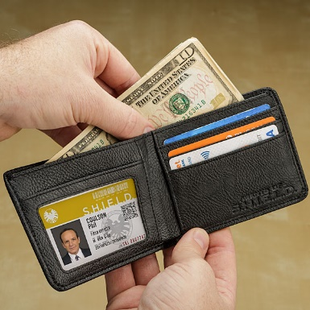


You Have The Right
To control your personal money and
have a job to make money.
To have privacy and talk to who you
want to privately and have your information
kept private.
To keep things of your own and see
current news and media.

Slide 18

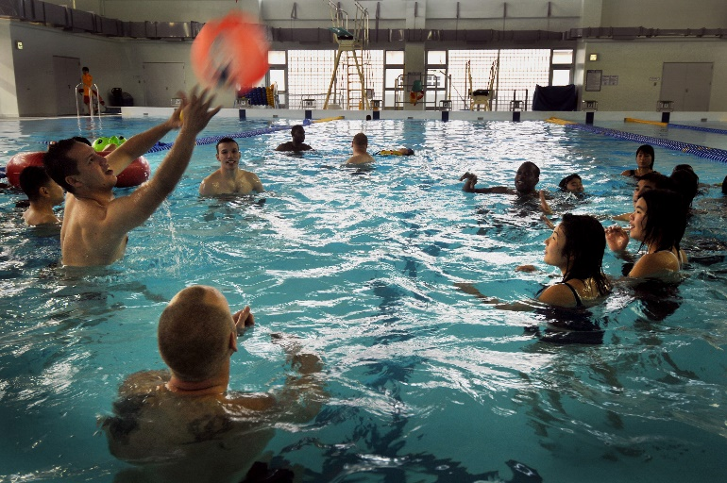

You Have The Right
To choose where and with whom you want to live.
To be a part of the community and participate in activities with people you choose.
To attend a place of worship of your choice, if you choose to do so.

Slide 19
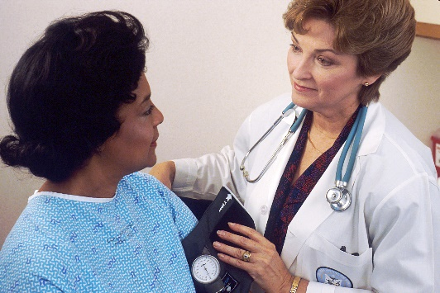


You Have The Right
To go to the doctor or hospital
when you need to.
To lead/participate in your plan meeting and invite those who are important to you & have your plan clearly explained to you.
To receive rules, policies and information about you in a way you can understand.

Slide 20
You have the Right to
Have choices of who supports you and to
Say “Yes” or “No” to Services
Notes:
You have the right to say Yes or No to Services

Slide 21



You Have The Right
To say NO to being part of any study, experiment or medical treatment.
To choose someone to help you make decisions or act on your behalf.
To have a person who does not work for our agency decide if we are complying with your rights.
Your Rights

Slide 22
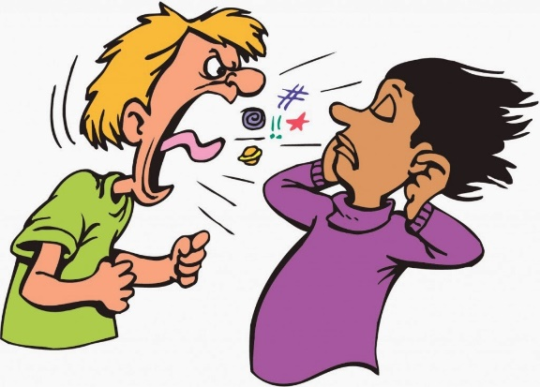

You have the Right:
To be free from people hitting you, hurting you, yelling at you, saying hurtful things or restricting your movement.
To be treated with respect at all times and to be treated like everyone else under the law.

Slide 23

Formal vs Informal Complaint
What's the difference between a formal and an informal
complaint?
An informal complaint is different from a formal complaint/grievance in how it is processed; however, resolution is the goal for each. An informal complaint is generally resolved through discussion and should always be attempted before moving into the formal complaint/grievance process.
You can make an informal complaint to the Director of the department you receive services (your support staff can assist you if needed). If you do not feel like your issue is resolved after making an informal complaint, you can make a formal complaint.
The formal complaint process is started when you, your guardian or family, completes a Grievance Form. After this form is processed, it is then investigated in accordance with our formal grievance procedure.
You will not be denied services or supports for making a complaint or grievance!

Slide 24

We will look into any reported issues or concerns you have with your services or supports and attempt to resolve them quickly.
Notes:
You have the right to offer complaints to the agency

Slide 25
Abuse & Neglect
You have the right to not be abused or neglected.
“Abuse” can be someone hurting you (either your body or your feelings, like someone calling you bad names).
“Neglect” is not getting the things/attention you need to be healthy and safe.
If you feel you have been abused, tell the staff or someone else in charge. They will let the right people know. Your staff are required to report any abuse or neglect they see or that people report to them.
We do not tolerate abuse or neglect and will make sure the issue is investigated and resolved as quickly as possible.

Slide 26

We will try to help resolve any concerns you have, but if you feel like your rights are not being respected or you wish to report abuse or neglect you can call:
Department of Mental Health Office of Consumer Safety toll free at 1-800-364-9687 8a-5p Monday-Friday
Or
Missouri Department of Health and Senior Services toll free at 1-800-392-0210 24-hr
Or
Missouri Protection & Advocacy (for advocacy & legal services) toll free at 1-800-392-8667 or MO Relay (TDD) call 1-800-735-2966
You can call anonymously (which means you do not have to tell them who you are).

Slide 27
Information about you will be kept private
Notes:
You have the right to have information about you kept private

Slide 28

Your Rights under HIPAA
Some of your rights are….
You can:
see a copy of your records
ask for changes to your information
ask with whom we have shared your information
talk to us at your home or in the office
have full copy of the Notice of Privacy Practices
make a complaint if you think any of your rights have not been met
Notes:
Your rights under HIPAA (the Health Insurance Portability and Accountability Act)
You can – see a copy of your records, ask for changes to your information, ask who we have given your information to, talk to us at your home or in the office, have a full copy of your Notice of Privacy Practices, make a complaint if you think any of your rights haven’t been met

Slide 29

Your Personal Information
Community Opportunities can give information about you without your permission for your treatment, payments of services or healthcare operations. So, we may share information with doctors, emergency staff, insurance companies or other agencies to make sure you have the care you need.
Notes:
Your Personal Information. Community Opportunities can give information about you to doctors, emergency staff, insurance companies or other agencies to make sure you have the care you need without asking you if it’s okay.

Slide 30
Community Resources
We have many resources available to you.
You will receive a list from your
program manager.
If you need help with something that is not on the list, please let us know.

Slide 31

Do you have any questions?

